Slide 1
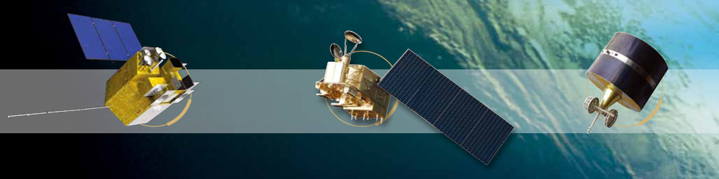
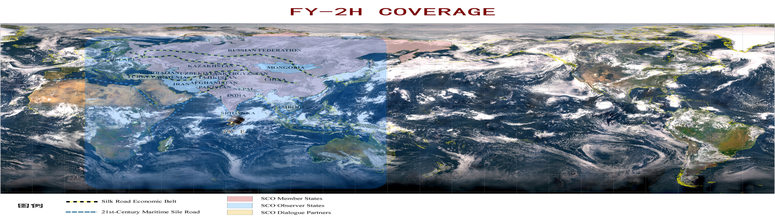


Fengyun Satellite Data Dissemination and Receiving Systems Introduction
Di XIAN (xiandi@cma.gov.cn)
National Satellite Meteorological Center
China Meteorological Administration
25 June 2019, Chengdu, China

Slide 2
Outline
satellite data & product
Data service introduction
Future plan

Slide 3
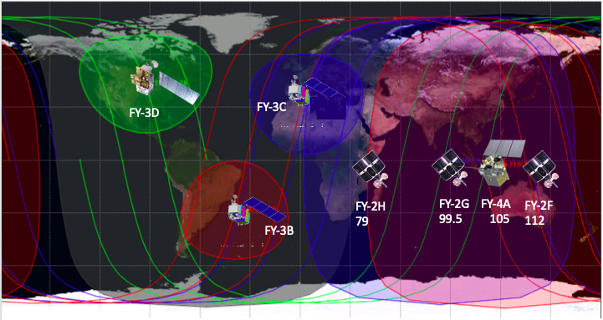
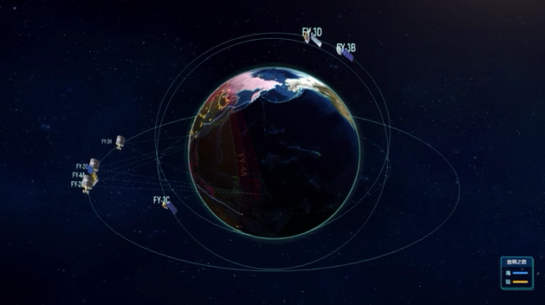
Satellite Data & product
FY GEO data | FY LEO Data
FY-2C/D/E/F/G/H (op.) | FY-1C/D (op.)
FY-4A(R&D) | FY-3A/B (R&D)
 | FY-3C (op.)
 | FY-3D (op.)
Others (cooperative missions)
TANSAT(R&D),CO2 & aerosol led by MOST
GF-4 (R&D), High Spatial Res. Imaging In GEO led by CNSA

Slide 4
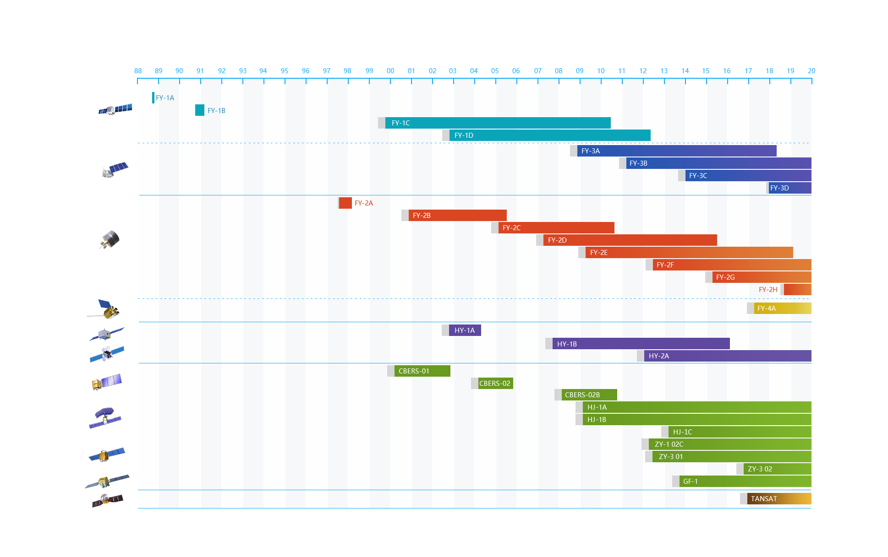
Historical Fengyun satellite data

Slide 5
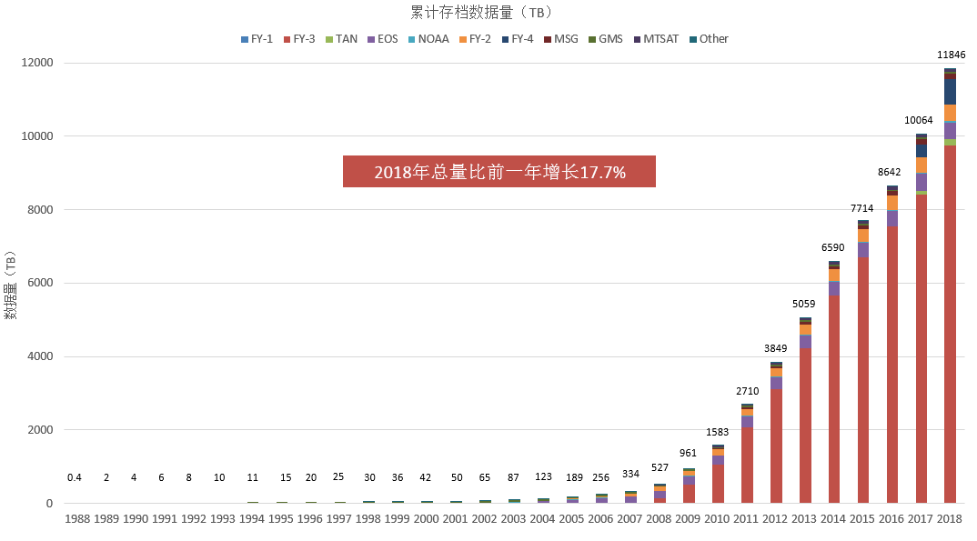
Total archived data amount

Slide 6
FY-2 and FY-4 Products
 | FY-4A | FY-2
Cloud | Cloud Mask Cloud Top Temperature Cloud Top Height Cloud Top Pressure Cloud Type Cloud Phase Daytime cloud optical and microphysical properties Nighttime cloud optical and microphysical properties | Cloud Mask Cloud Top Temperature Cloud Classification Cloud Cover Ratio Cloud Total Amount
Atmosphere | Quantitative Precipitation Estimate Layer Perceptible Water Atmosphere Motion Vector Atmospheric Temperature Profile Atmospheric Humidity Profile Cloudy Vertical Temperature Profile Cloudy Vertical Moisture Profile Aerosol Detection Atmosphere Instability Index Convective Initiation Tropopause Folding Turbulence Prediction Total Ozone Amout Ozone Profile | Precipitation Index Quantitative Precipitation Estimate Clear sky Total Perceptible Water Atmosphere Motion Vector Cloudy Vertical Moisture Profile Upper Tropopause Humidity

Slide 7
FY-2 and FY-4 Products
 | FY-4A | FY-2
Radiance | Outgoing Long wave Radiation Surface Solar Irradiance Downward Longwave Radiation Upward Longwave Radiation Reflected Shortwave Radiation | Outgoing Long wave Radiation Surface Solar Irradiance
Surface | Sea Surface Temperature (Skin) Land Surface Temperature Snow Cover Land Surface Albedo Land Surface Emissivity Evapotranspiration products | Sea Surface Temperature (Skin) Land Surface Temperature Snow Cover
Environment | Dust Smoke Detection Fire/Hot Spot Characterization Fog Detection | Dust Index Fire/Hot Spot Characterization Heavy Fog Detection
Lightning | One Minute Lightning Quantitative Product (including flash group event) Lightning Jump Identification Product Flash Daily Density
Space | High-energy particle distribution Magnetic Field Intensity Space Environment Effect

Slide 8
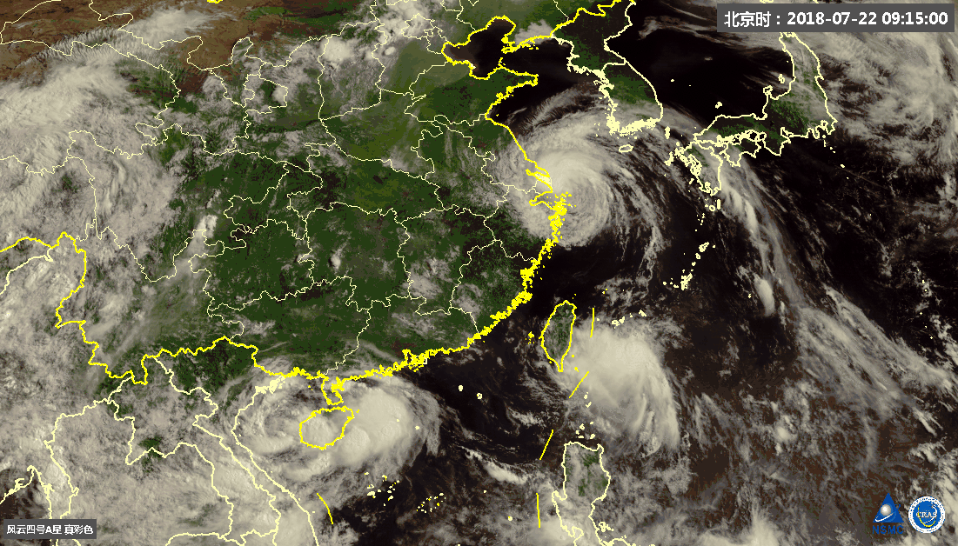
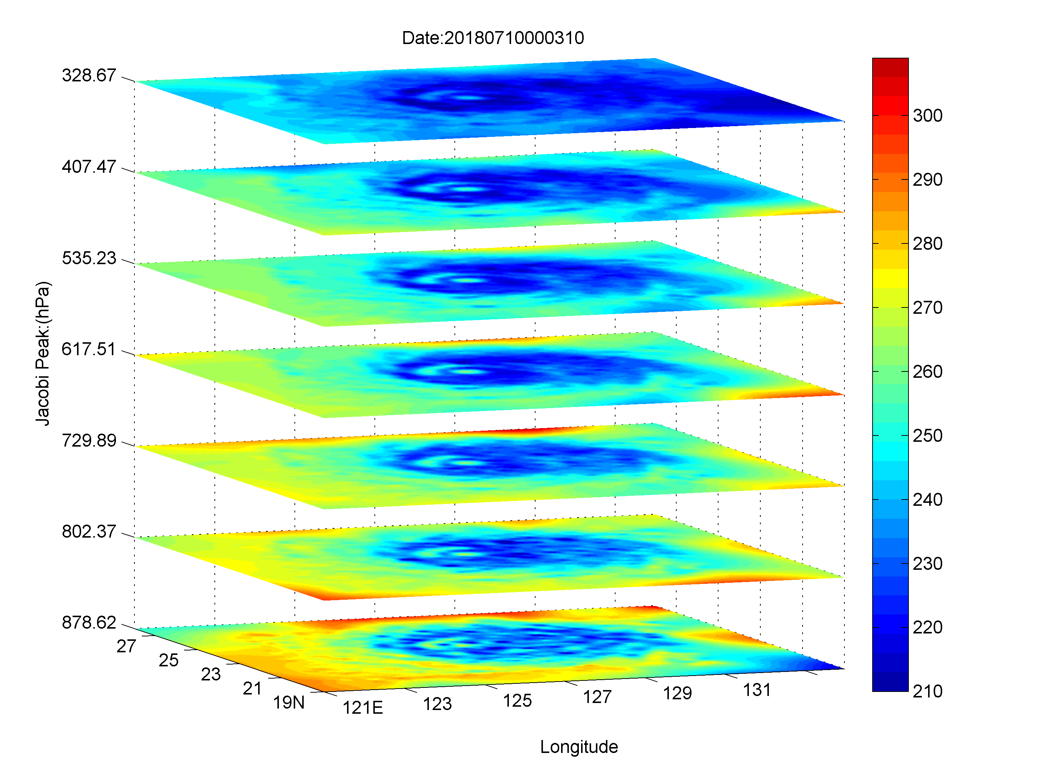
FY-4A GIIRS humidity sounding
(Every 15 minutes)
FY-4 Product example
Typhoon Maria

Slide 9
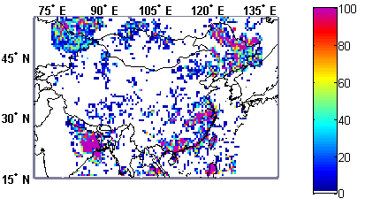
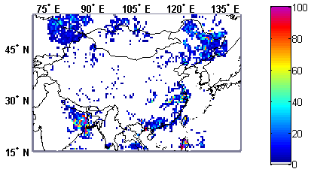
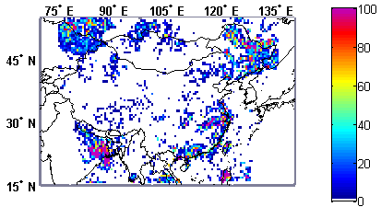
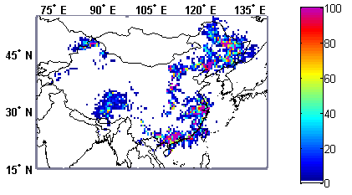
FY-4 Product example
20170701 LMI Event
20170701 LMI Flash
20170701 LMI Group
20170701 surface based lighting
Notes:
20170621 00:04-14:00 华北和黄淮地区一次雷暴过程Flash和Group闪电频数分布图，以及地基闪电定位网地闪频数分布图
图像分辨率0.5度

Slide 10
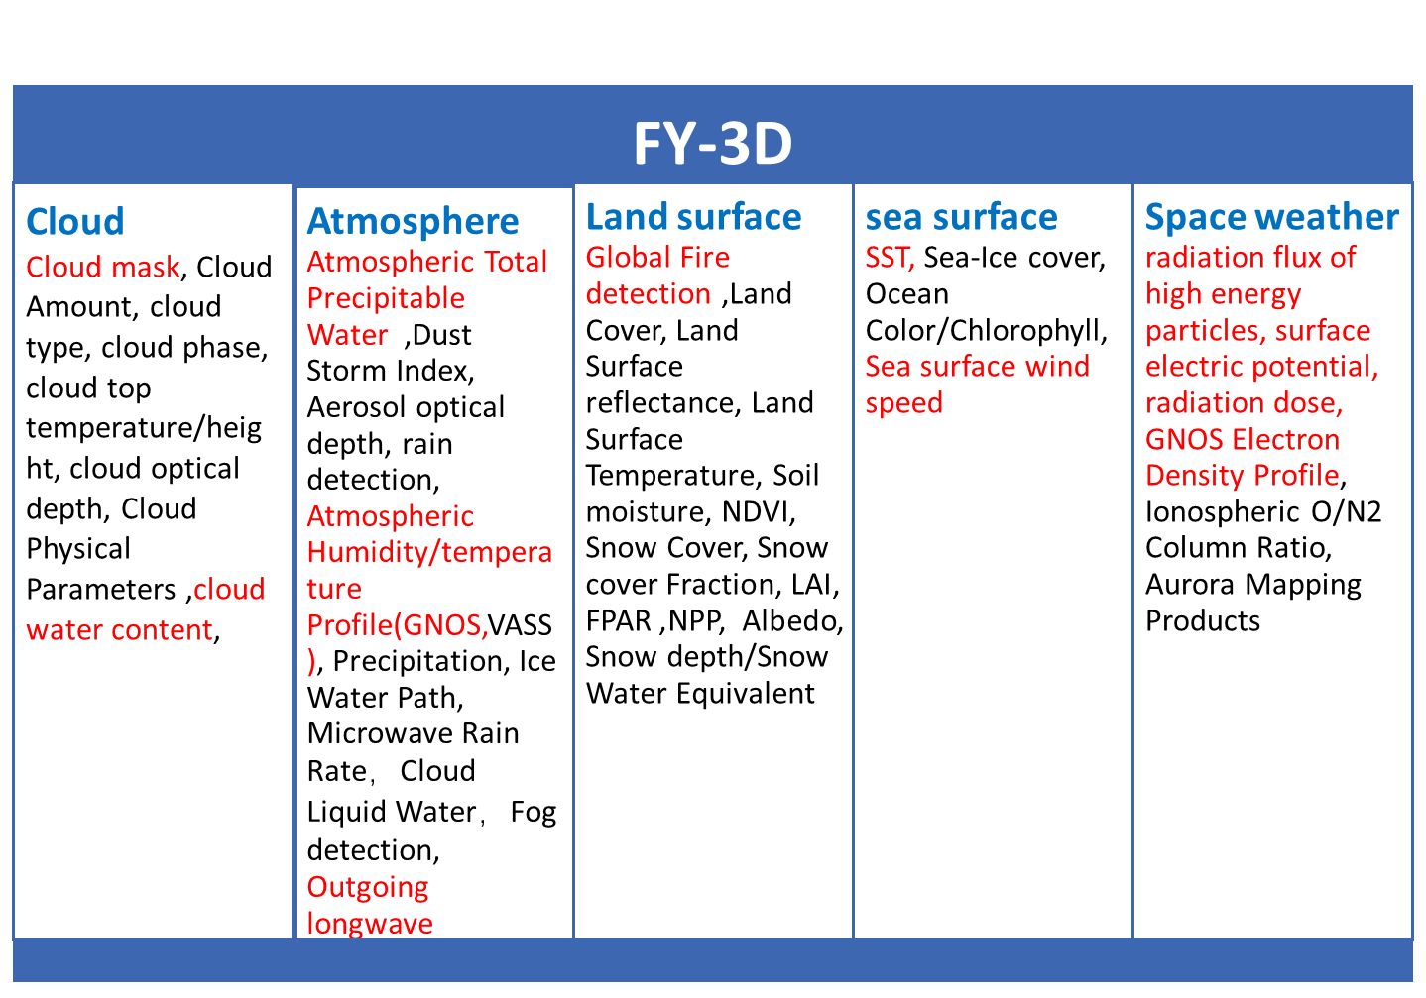
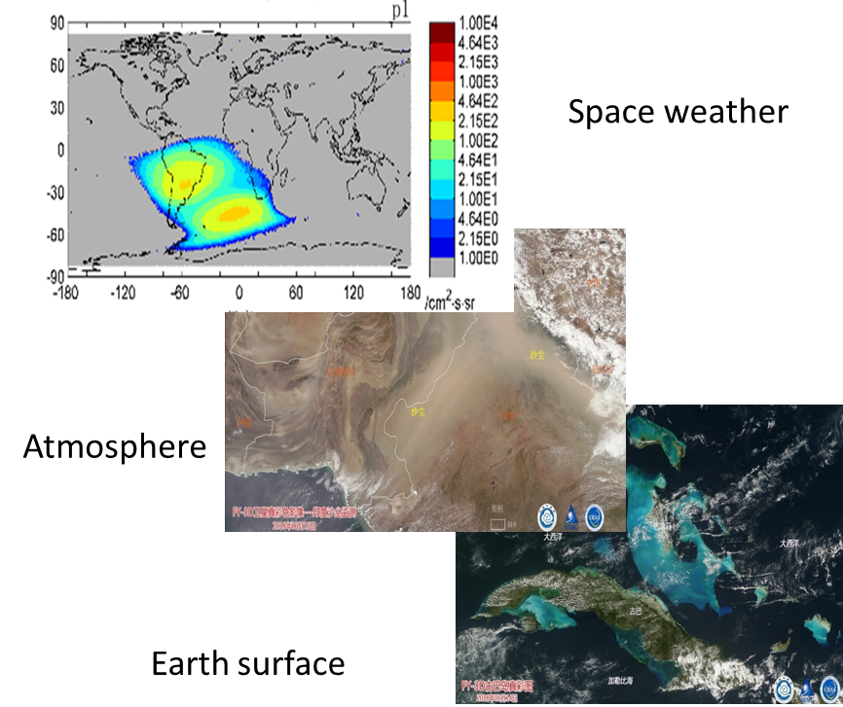
FY-3 products

Slide 11
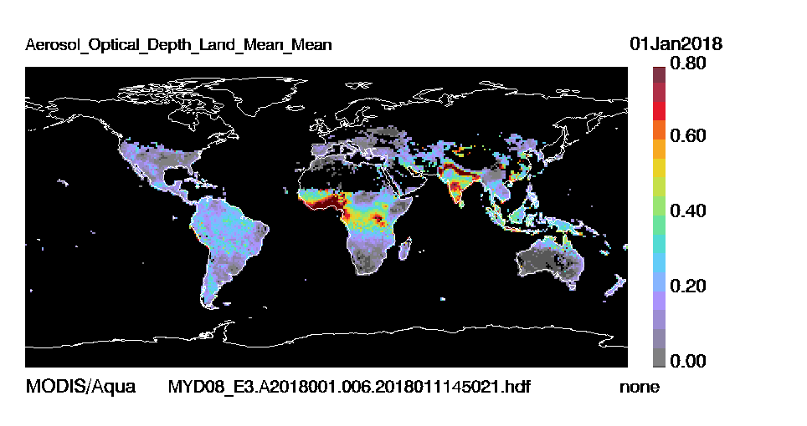
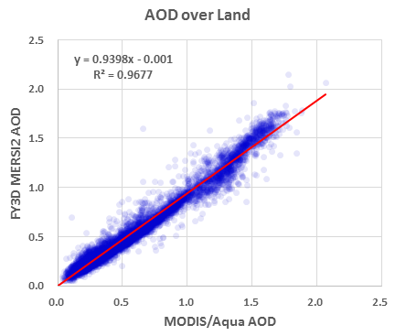
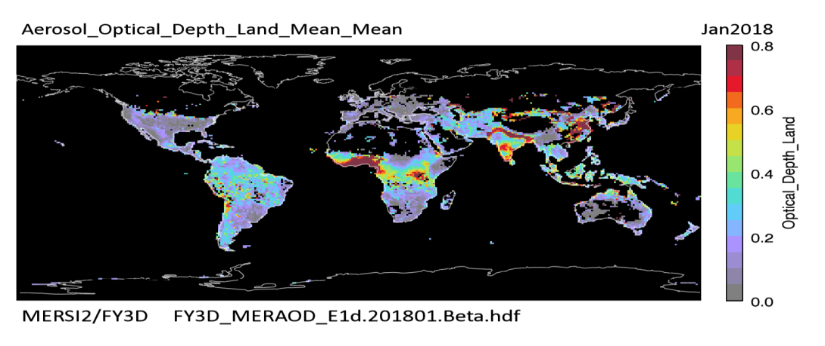
FY-3 product example
Aqua/MODIS
AOD：MERSI II & Aqua/MODIS
FY-3D/MERSI2

Slide 12
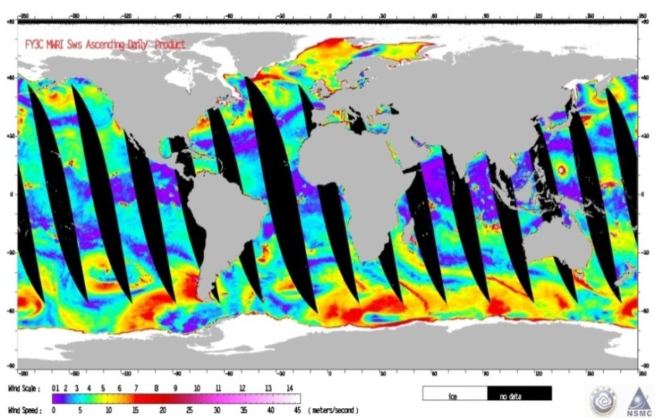
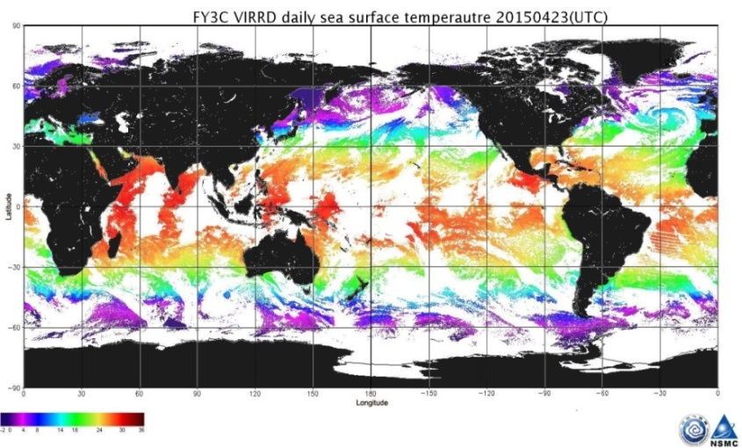
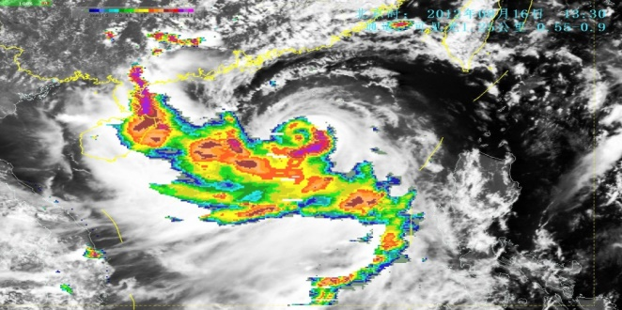
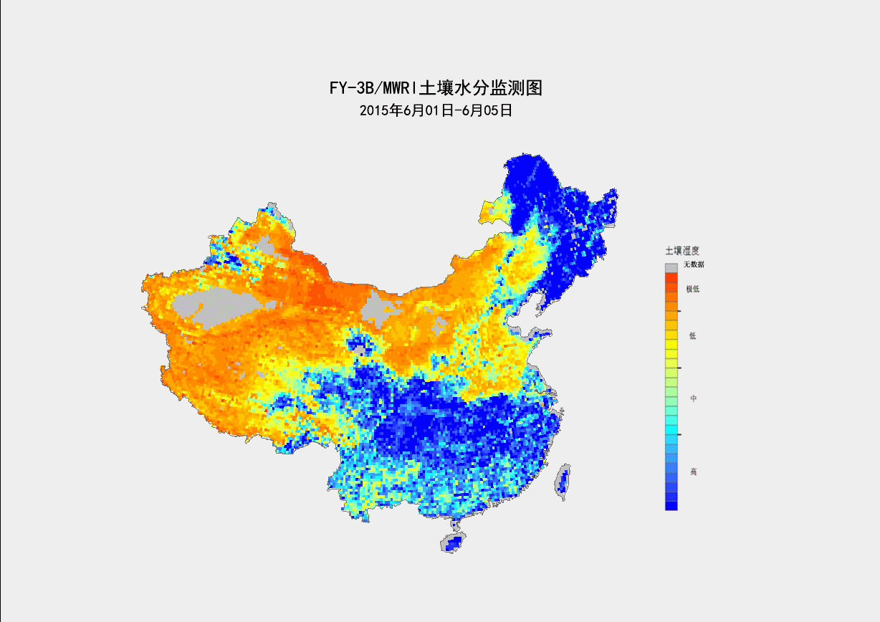
FY-3 product example
FY3B/C-MWRI sea wind
FY3C-VIRR SST
FY3B/C-MWRI soil water content
FY-3 microwave precipitation products

Slide 13



Data format
Satellite | Format
FY-1 | L1B, HDF4.0
FY-2 | HDF5.0, AWX2.1
FY-3 | HDF5.0
FY-4 | HDF5.0, NetCDF

Slide 14
Outline
satellite data & product
Data service introduction
Future plan

Slide 15
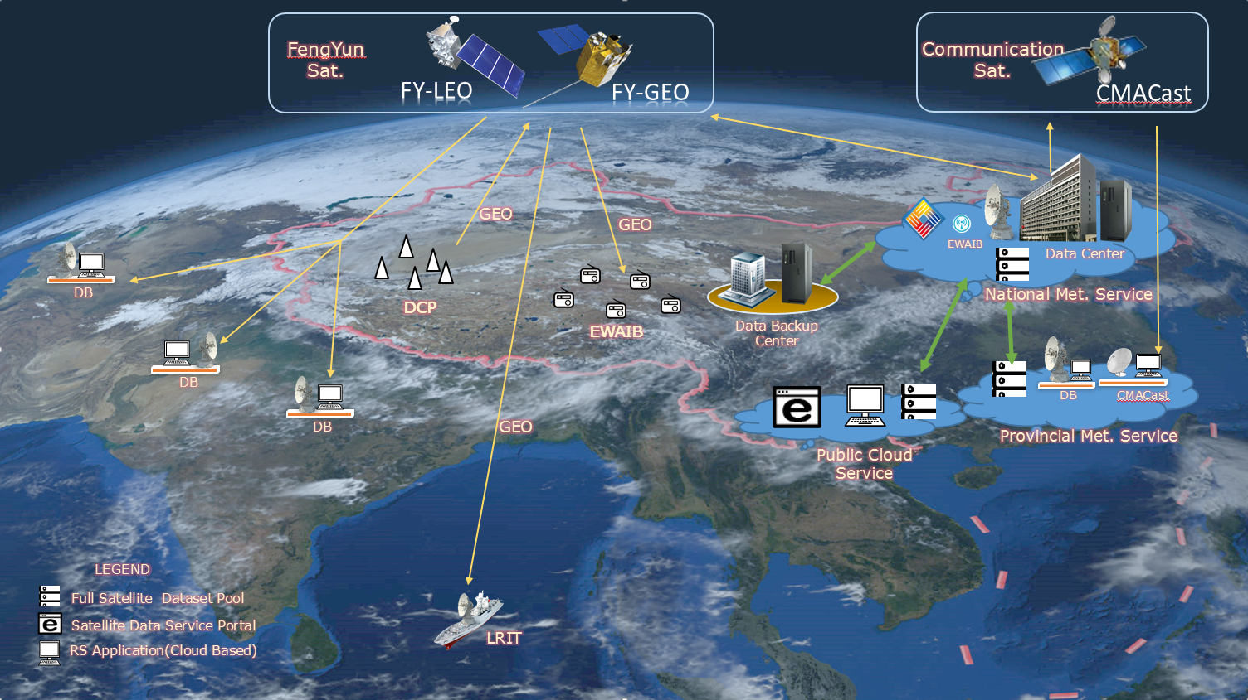
Integrated Space and Ground Based FY Satellite Data Service System
FOR International Community：Data Service Portal (Public cloud based)；FengYun DB (authorized)；CMACast (authorized)；

Slide 16
1) Space-based data services
Type | User | Time
FY-2 Direct Receiving Station | All users | Real-time dataset | L1 data
FY-3 Direct Receiving Station | All users | Real-time dataset | L1 data
FY-4 Direct Receiving Station | All users | Real-time dataset | L1, L2 data
FY-3 Preprocessing Software Packages | All users | Real-time dataset | 5 instruments data
CMACast | All users | Real-time dataset | Satellite data, NWP data and Observation data

Slide 17
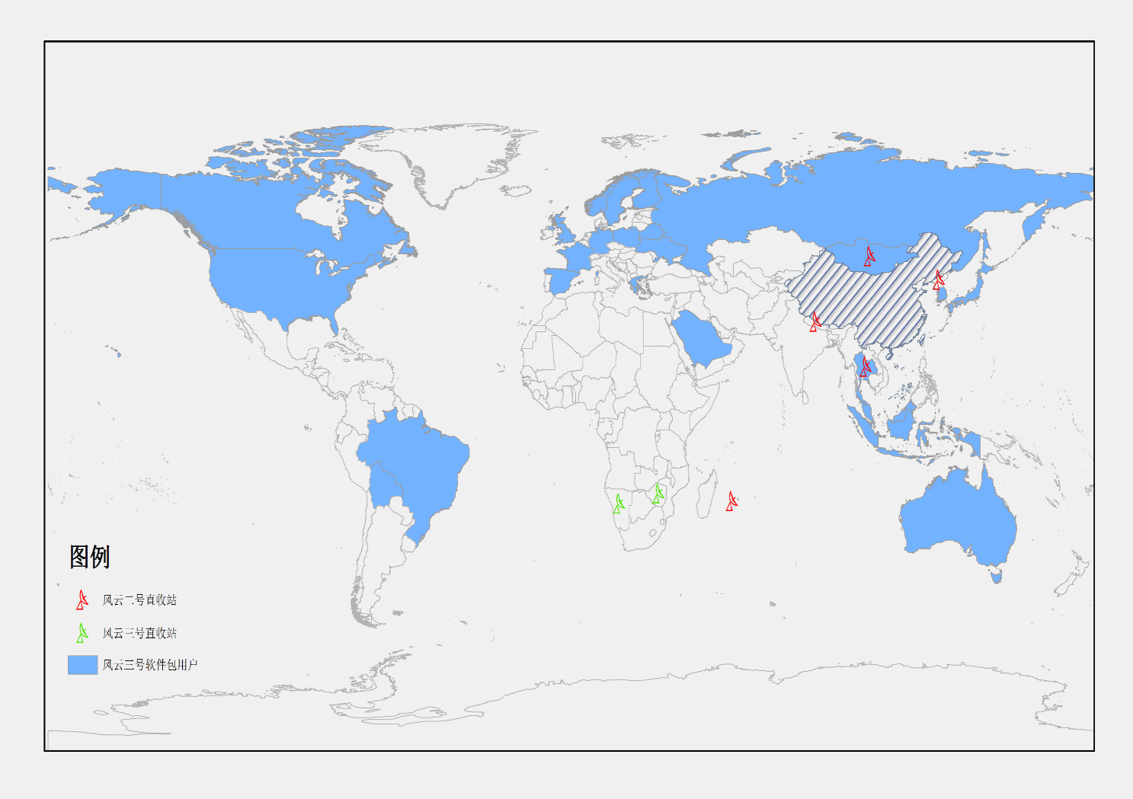
1) Space-based data services
FENGYUN satellite Direct Broadcasting System (FY-DBS)
FY-2 DB Station: 5 countries
FY-3 DB Station: 2 countries
FY-3 Data Preprocessing Software packages: 24 countries, 48 users
As of June 2019

Slide 18
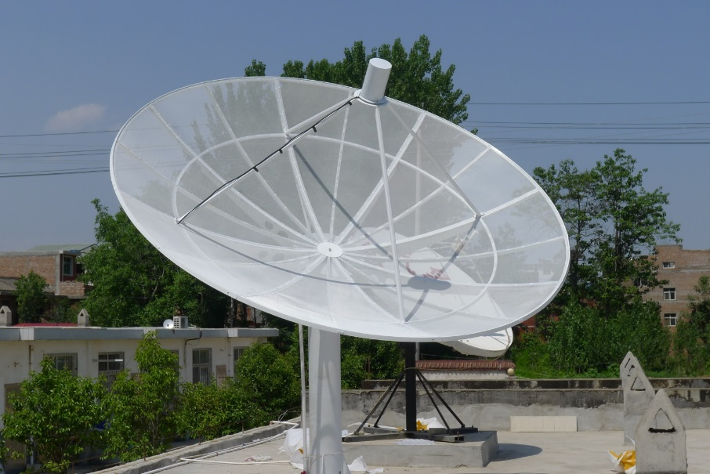
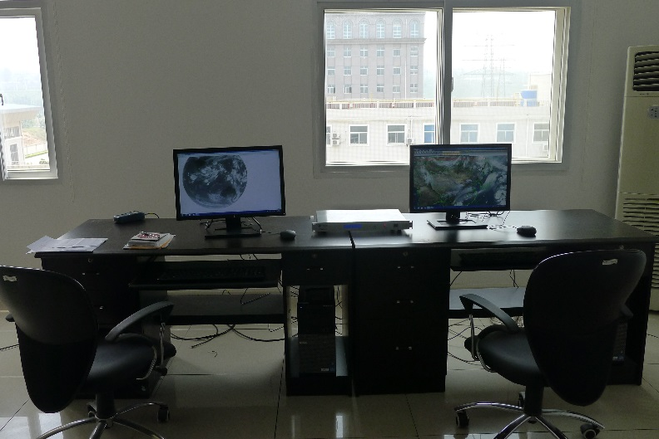
1) Space-based data services
FY-2 Direct Receiving Station
FY-2 Meteorological Satellite Data Direct Receiving Station can receive, process Chinese FY2 satellites S-VISSR broadening cloud data, it is an integrated system include data receiving, data processing, application and data sharing.

Slide 19
1) Space-based data services
FY-3 Direct Receiving Station
  System Functions and Constitution：
    Polar orbit meteorological satellite(FY-3,MODIS,etc.) real-time direct broadcasting data receiving equipment and operation monitoring software。
    Satellite data processing software(Preprocessing, interactive project)
    Ecological Monitoring Products generation software（drought/soil moisture，fire，vegetation growth, water body）
Supporting Satellites
Satellite | Highest Resolution
FY-3B/3C/3D | 250m
NOAA-18/19 | 1100m
AQUA/TERRA | 250m
NPP/JPSS-1 | 375m
Metop-B/C | 1100m

Slide 20
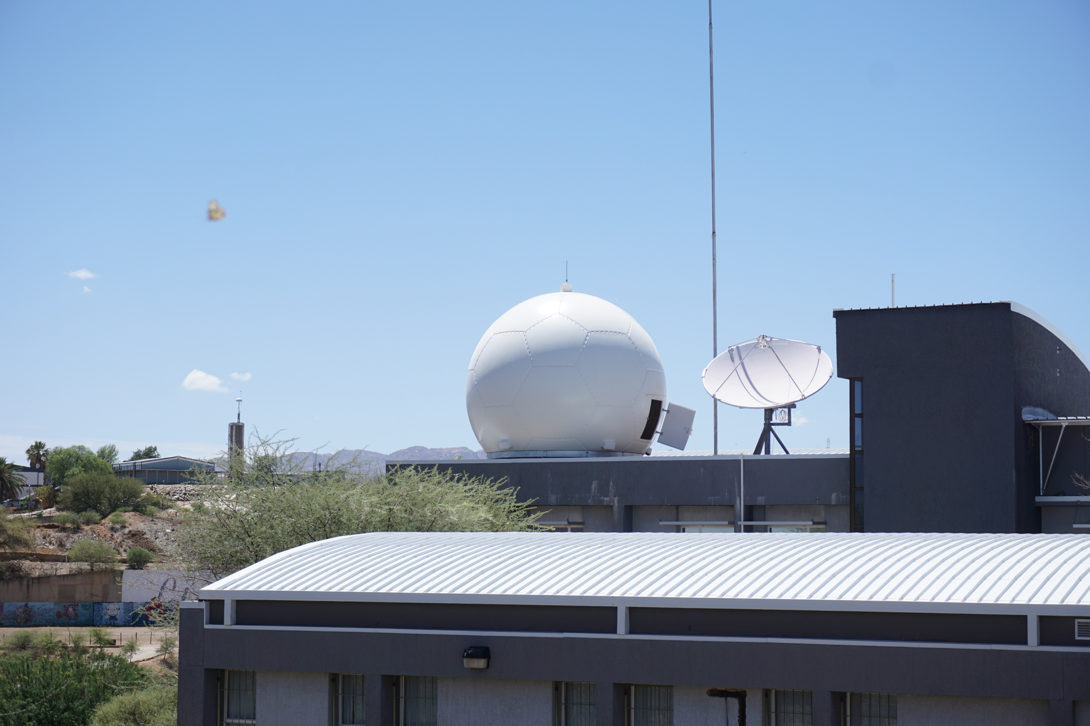
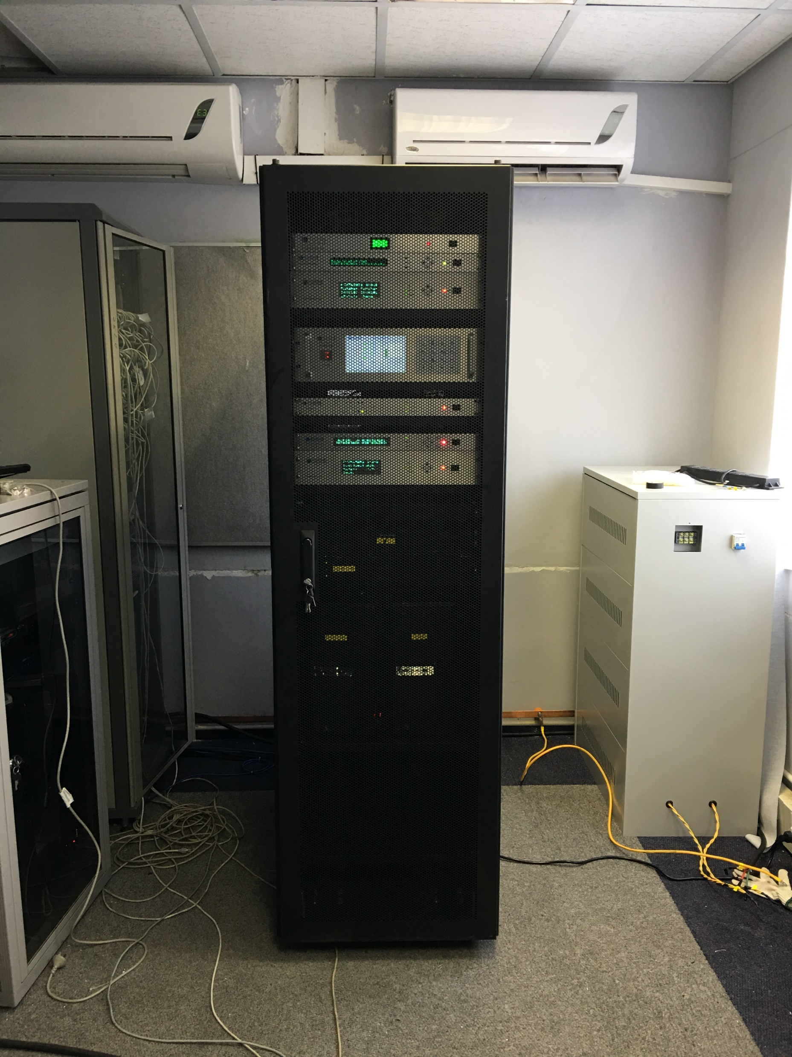
1) Space-based data services
List Of FY-3 DB Products
Name | Level | Timeliness
HDF | L1 | <30 minutes
Fire | L2 | Auto or manual <30 minutes
Water | L2 | Auto or manual <30 minutes
Vegetation | L2 | Auto or manual <30 minutes
Drought | L2 | Auto or manual <30 minutes
More… | customizable

Slide 21
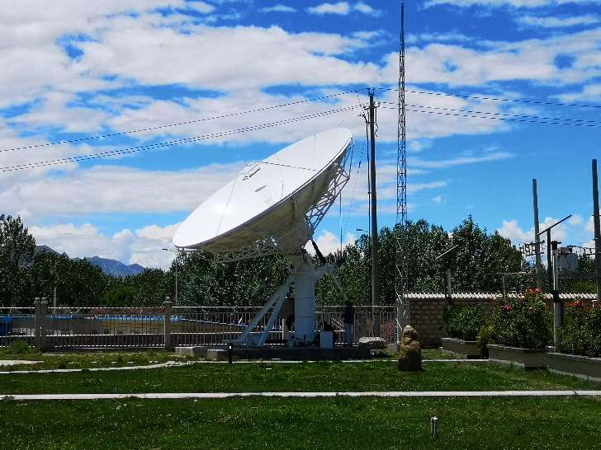
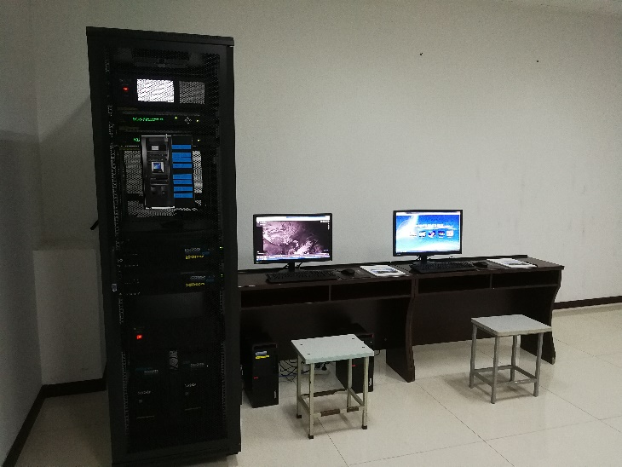
1) Space-based data services
FY-4 Direct Receiving Station
FY-4 series is China’s second-generation quantitative remote sensing geostationary meteorological satellites. It is the most advanced meteorological satellite in the modern era.Its successive and stable operation, enabled by the three-axis stabilization used to upgrade the FY-2 attitude control system of spin stabilization, significantly improves China’s geostationary meteorological satellite detection and observation standards. FY-4 is the first satellite in the worId that accomplished hyper-spectral vertical atmospheric sounding from geostationary orbit, to acquire atmospheric temperature and water vapor profile with a high-frequency high-precision vertical observation of the atmosphere.

Slide 22
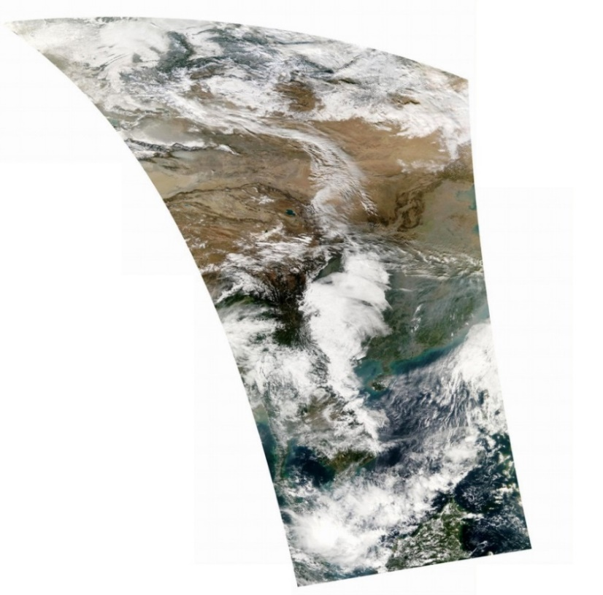
1) Space-based data services
FY-3 preprocessing software packages are freely access to all NMHs
  FY-3B/C: MERSI, VIRR, IRAS, MWHS,MWTS and MWRI
  FY-3D: MERSI, HIRAS, MWHS, MWTS, and MWRI
How to apply?
  Application form: http://data.nsmc.org.cn/PortalSite/StaticContent/DocumentDownload.aspx?TypeID=8

Slide 23
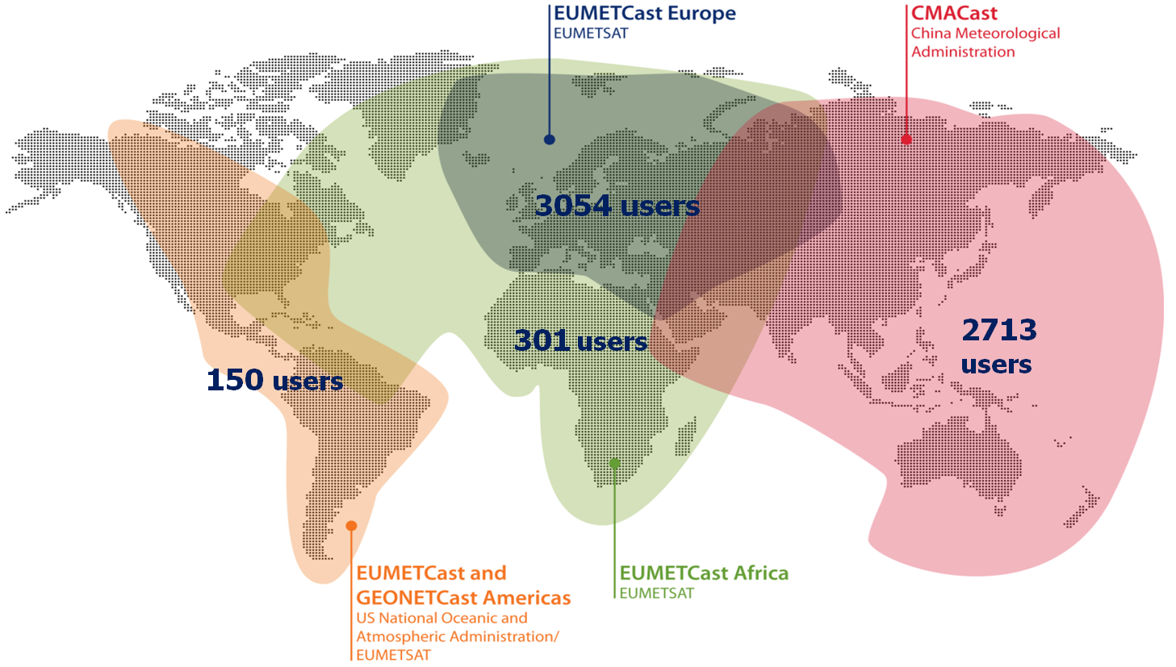
1) Space-based data services
CMA satellite data broadcasting system (CMACast)
CMACast has been deployed in 19 countries

Slide 24
  2) Ground-based data services
Type | User | Time | Services | Protocol
Intranet service | CMA main users | Real-time dataset | File access | NAS FTP API
 | CMA intranet users | Real-time dataset
Website order | All user | All dataset | On-line order | HTTP
 |  | Real-time dataset | Download | FTP
Customize order | Agreement user | All dataset | Customize | HTTP
Data client | All user | All dataset | On-line order | PC client
 |  | Real-time dataset | Data subscribe
Cloud service | All user | Real-time dataset | Data subscribe | Cloud client
Sub-service center | All user | Real-time dataset | On-line order | HTTP
API | All user | All dataset | API | API

Slide 25
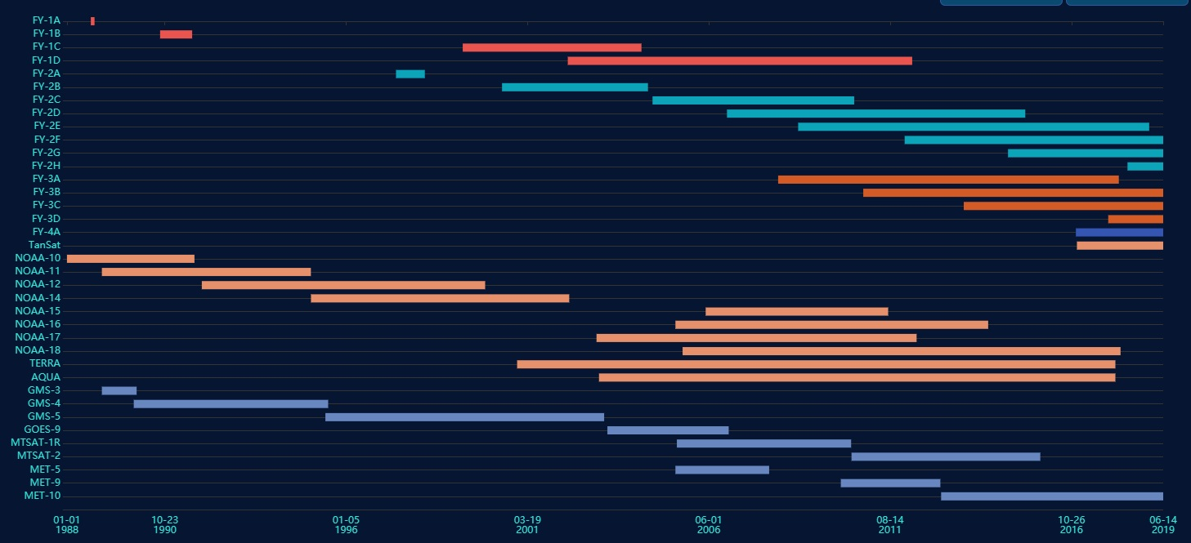
Archived Data in NSMC(37 satellites)

Slide 26
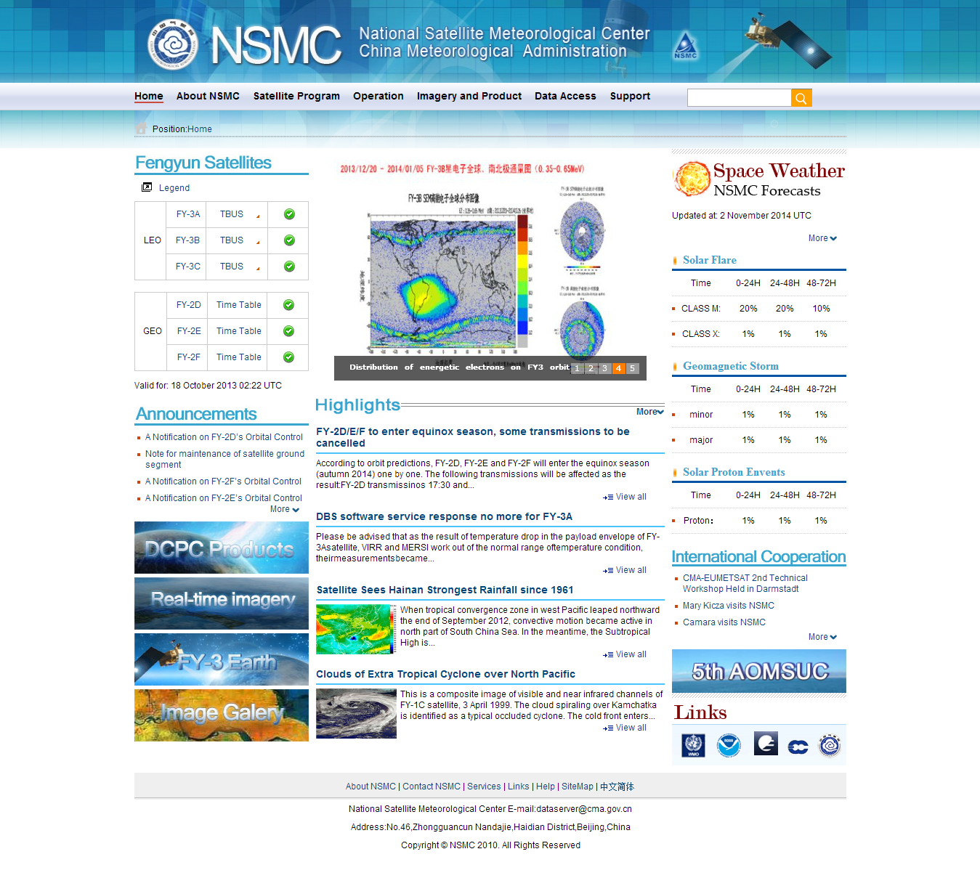
Data Service based on web
NSMC Portal
http://www.nsmc.gov.cn/en
Satellite information and status
Operational announcement
News
Space weather information
Cloud images and animation

Slide 27
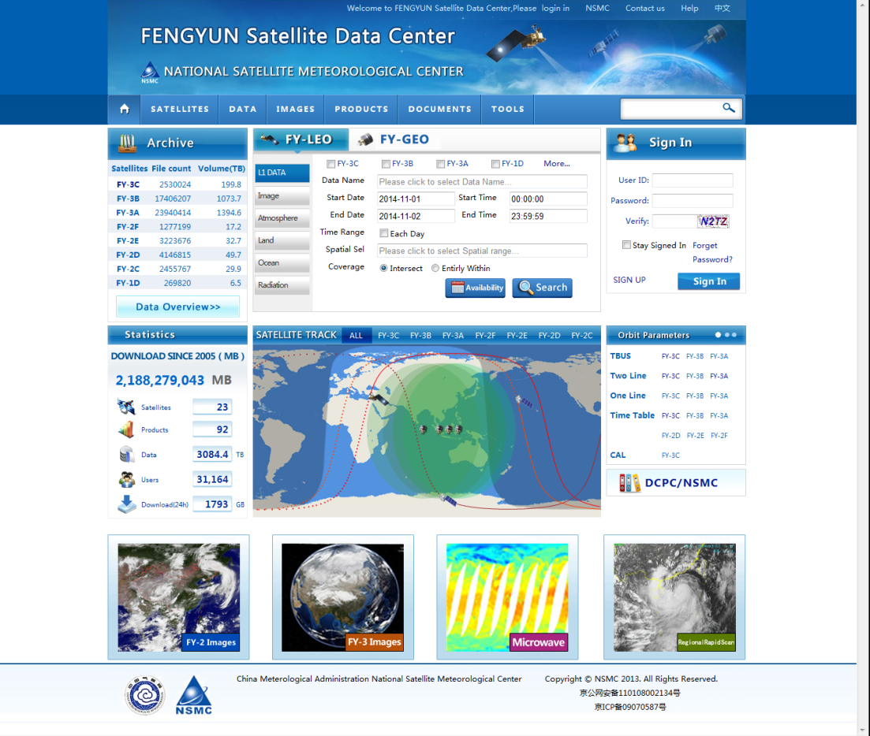
Data Service based on web
http://data.nsmc.org.cn
All 10PB archived data (real time)
Satellites' information
Satellite images browse
Documents and toolkitsools
User： freely register, update need authorized

Slide 28
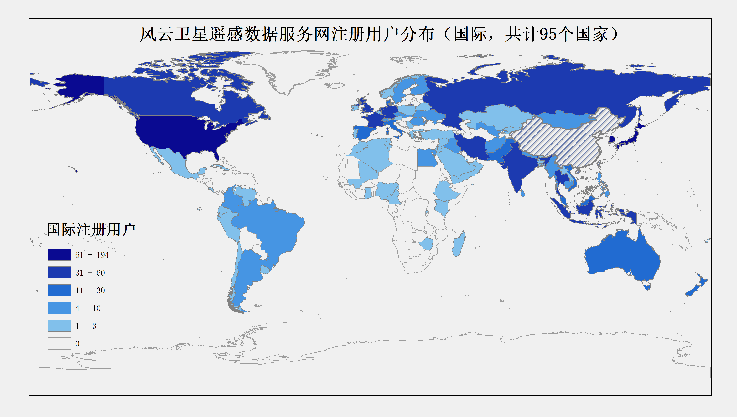
Data Service Web Portal Performance
By the end of 2018:
  Total register users: 67817
  Total order amount: 47,704
In 2018: 4.99PB data downloaded, 90% FY data
As of 2018

Slide 29
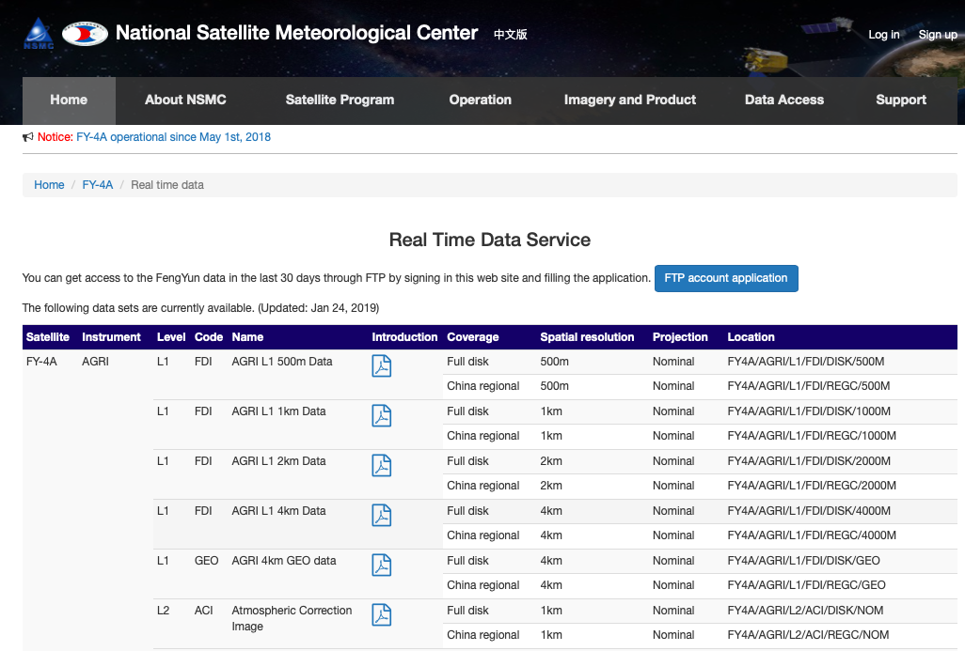
Data Service based on FTP
FY-4A NRT data Also available on NSMC NRT data pool (http://fy4.nsmc.org.cn/data/en/data/realtime.html)
Become a registered users of NSMC data service
Apply a FTP account
Download data from NSMC ftp server

Slide 30
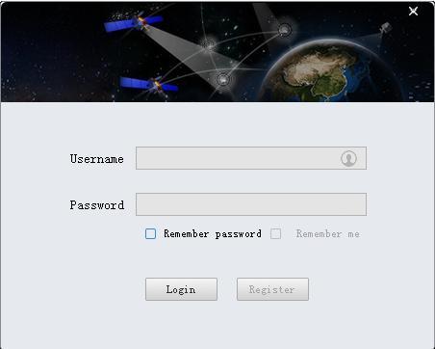
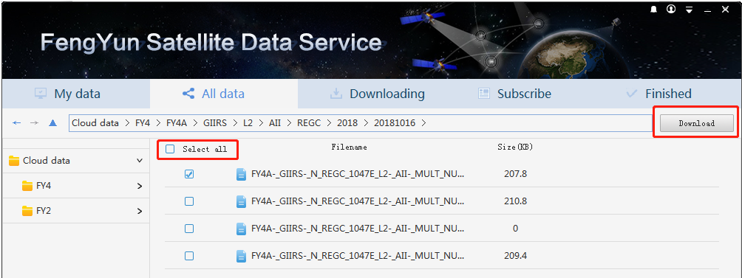
Data Service via download toolkit
Main features:
Download automatically;
Data reservation;
No data quantum limitation;
Public cloud supported
Support Windows, Mac and Linux

Slide 31
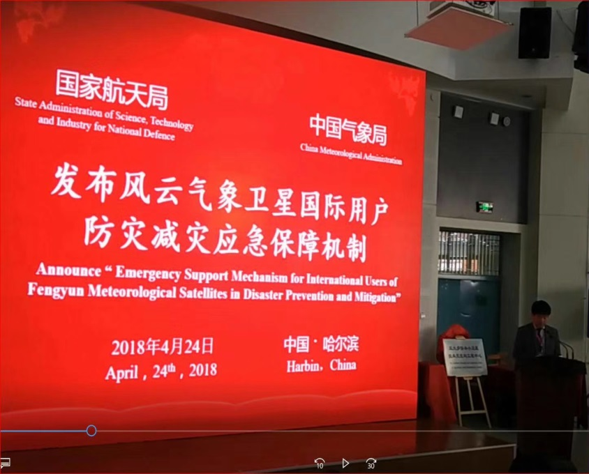
3）Emergency Support Mechanism of FENGYUN Satellite（FY ESM）
Conditions for a Request
An international user may request CMA to activate FY ESM before, during and after an extreme event such as typhoon, heavy rain, severe convection, forest or grassland fire and sand and dust storm, etc., with one of the following references provided:
Typhoon: The central wind force exceeds 28m/s and the impact is expected to be felt within 24 hours;
Heavy rain and severe convection: It is expected that the rainfall will exceed 200mm within 24 hours;
Fire: A forest/grassland fire breaks out, posing a grave threat;
Flood: A widespread flood looms large; · Other extreme events predicted to pose a grave threat.
issued On April 24th,2018
Once the request is approved, CMA will command the on-duty FY satellite for frequent and targeted observation over affected areas.

Slide 32
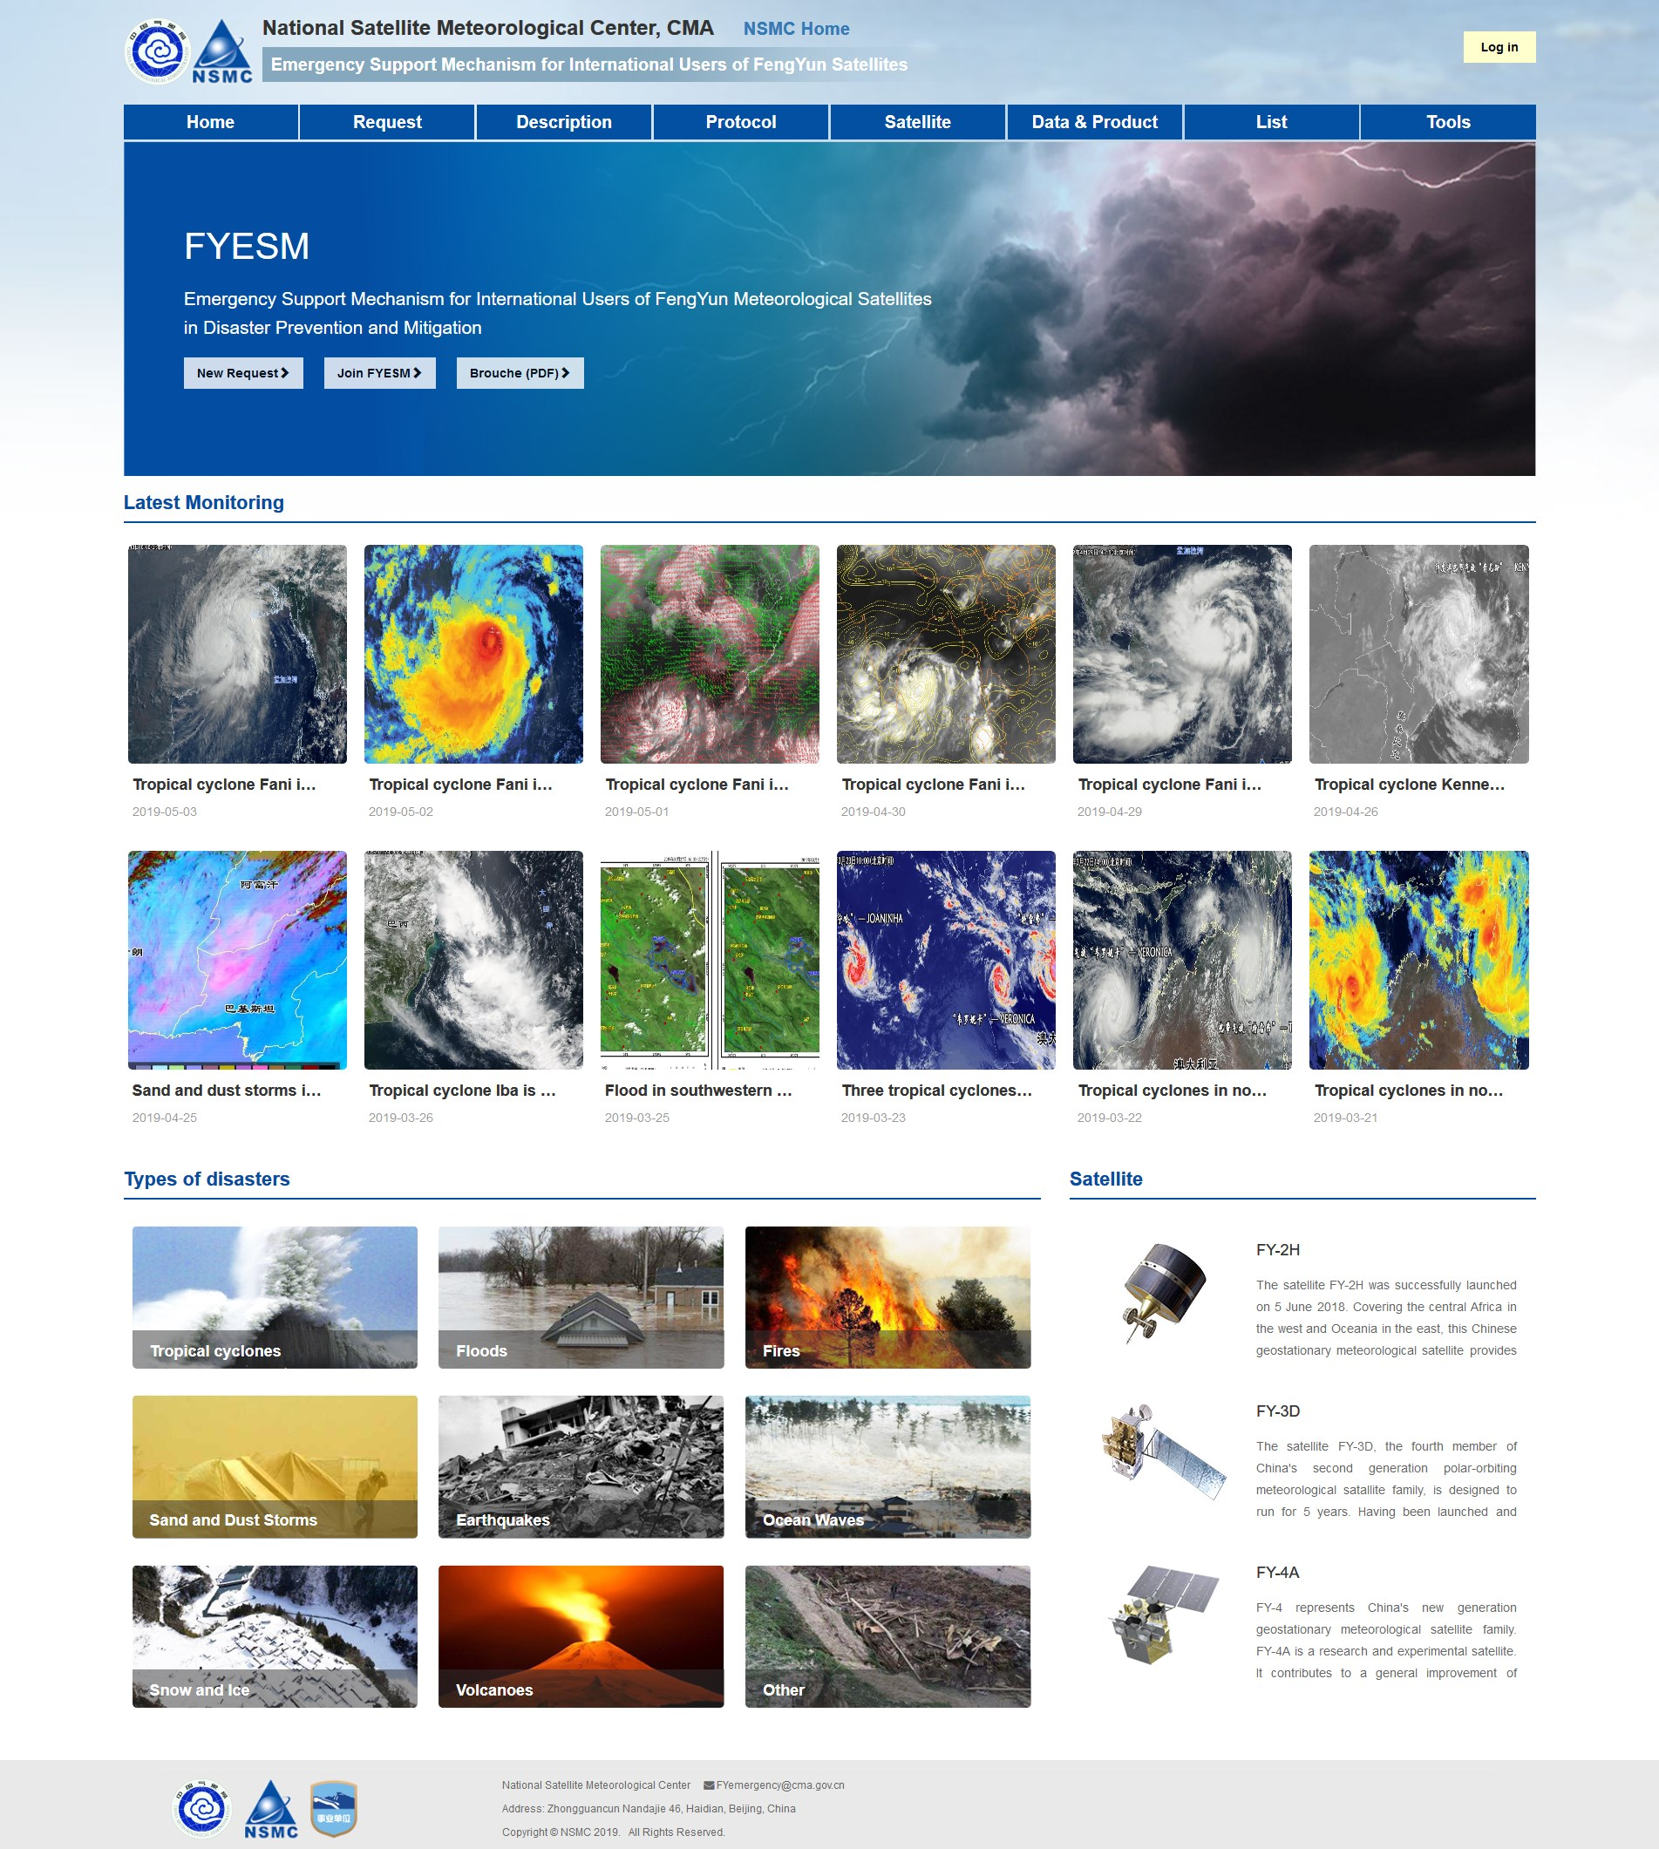
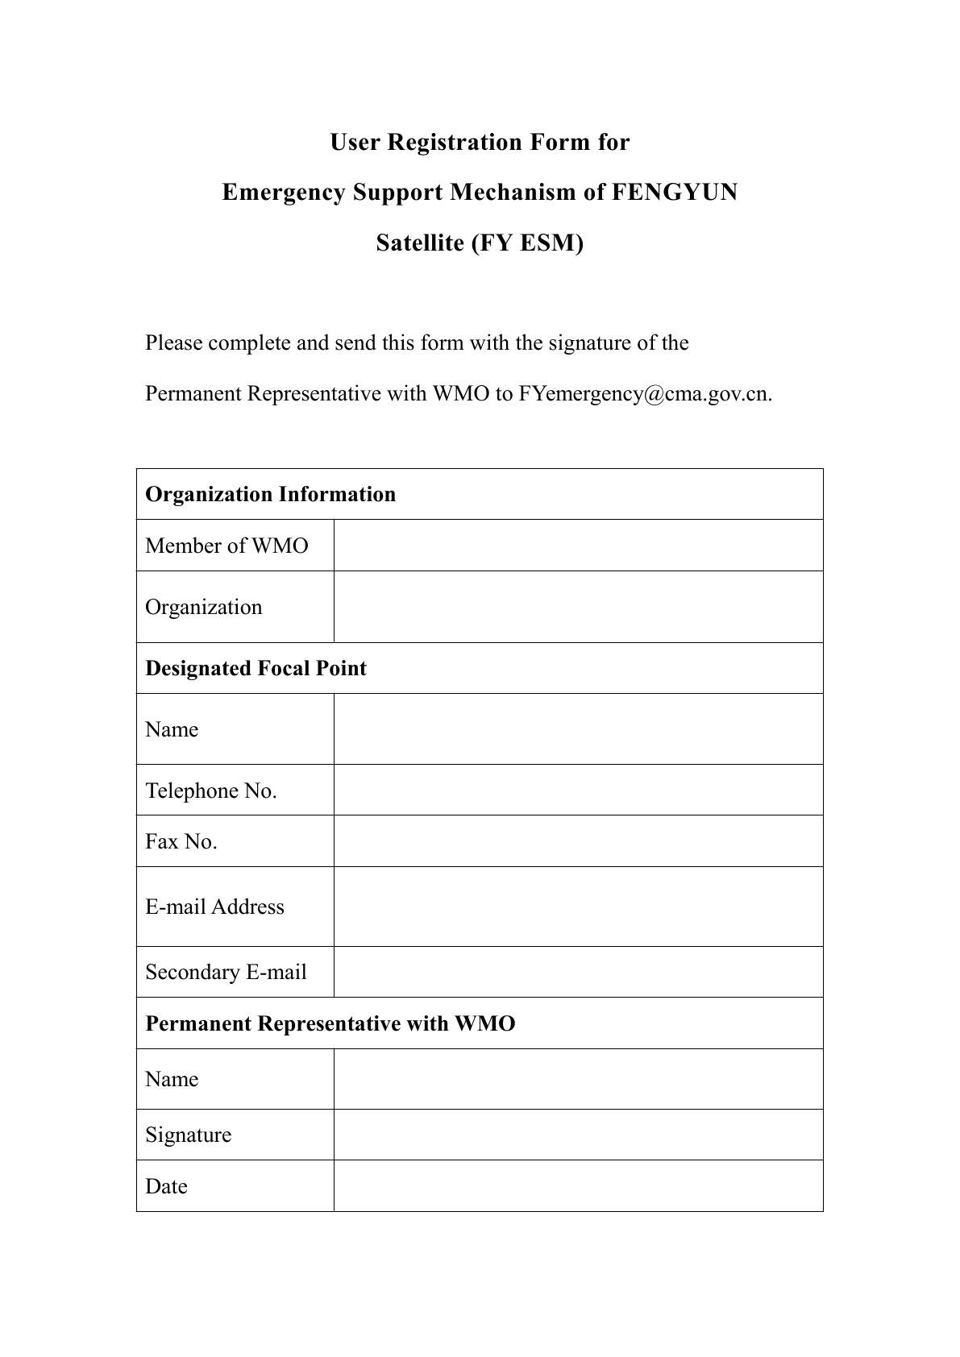
Join and initiate FY_ESM
https://fy4.nsmc.org.cn/service/en/emergency/index.html

Slide 33
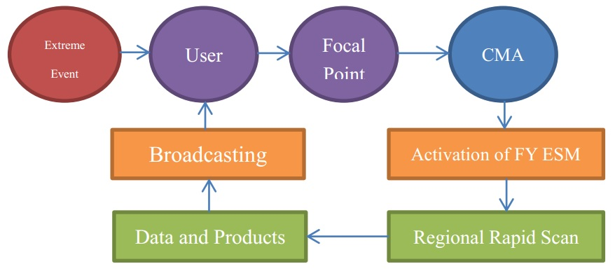
Procedure
Request preferably 24 hours in advance, with the maximum duration of intensive observation being no more than 48 hours.
Each requested duration shall not exceed 7 days. Any extension needs to be re-requested.

Slide 34
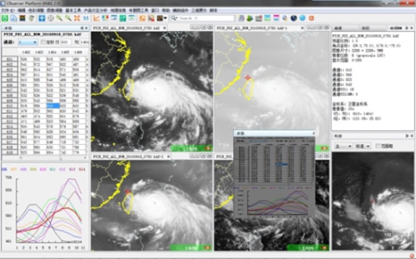
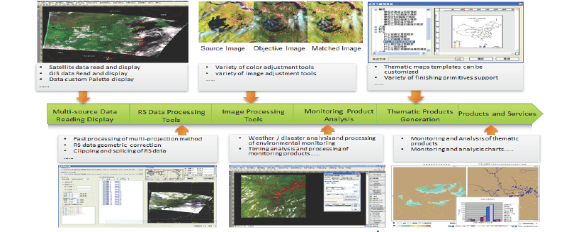
4） Applications
SATs: New Observation Capability
Weather monitoring and analysis
---Geostationary Satellite data (FY-2/FY-4)
Satellite Weather Application Platform SWAP
Application tools
Natural disaster and environment monitoring and analysis
---polar orbiting Satellite data
Users: New Applications
Satellite Monitoring Application Remote sensing Toolkit
SMART

Slide 35
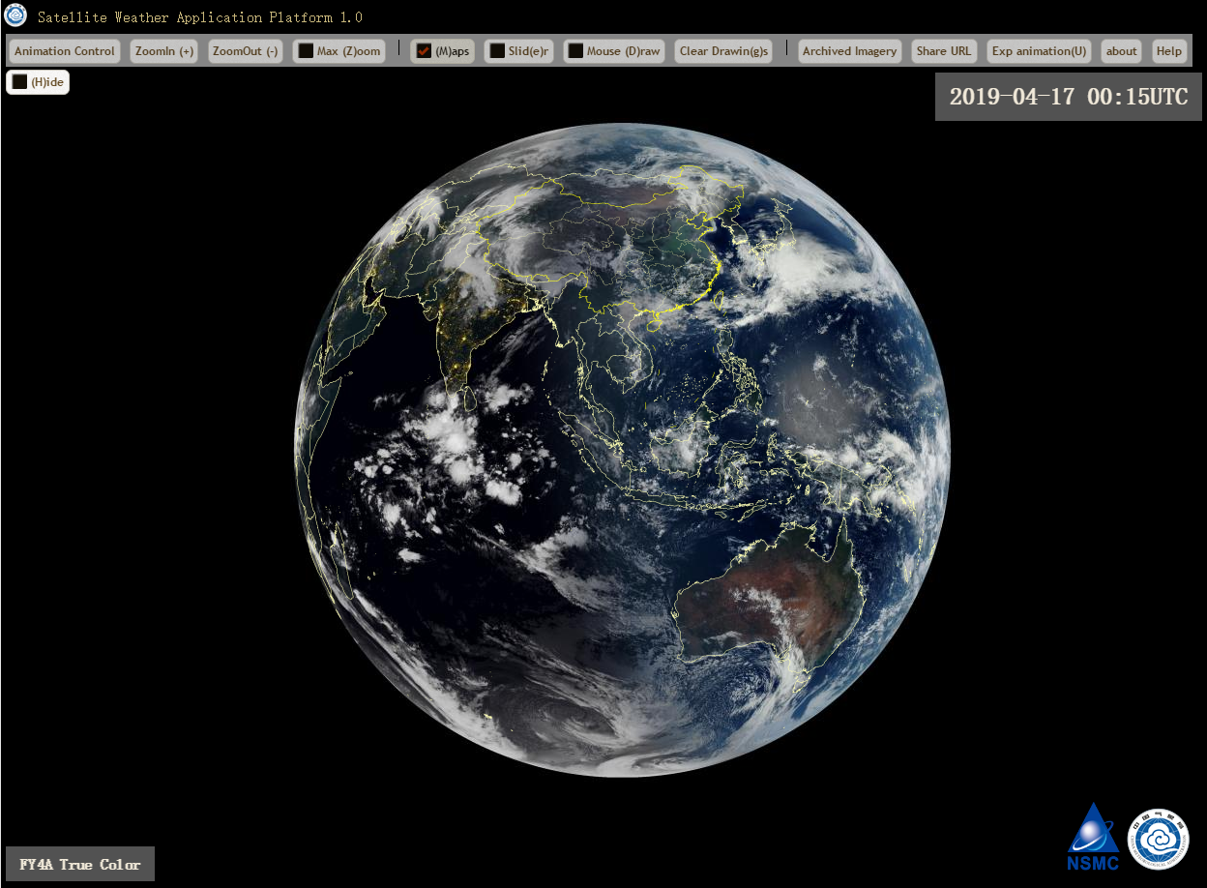
Prototype of FENGYUN “cloud+end “ remote sensing platform-GEO satellites
https://fy4.nsmc.org.cn/mips/index.html

Slide 36
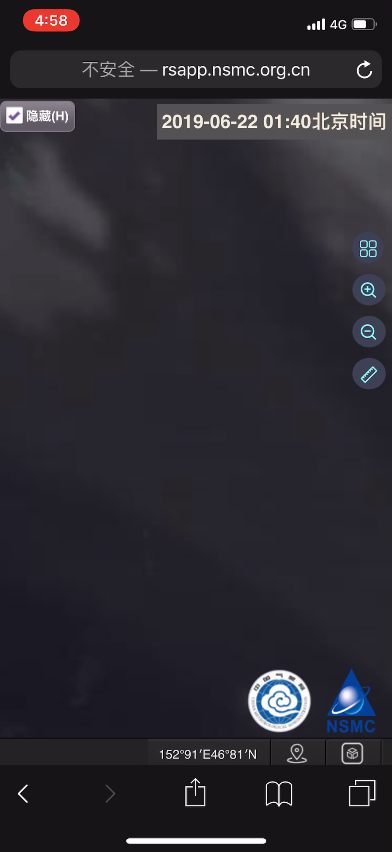

Slide 37
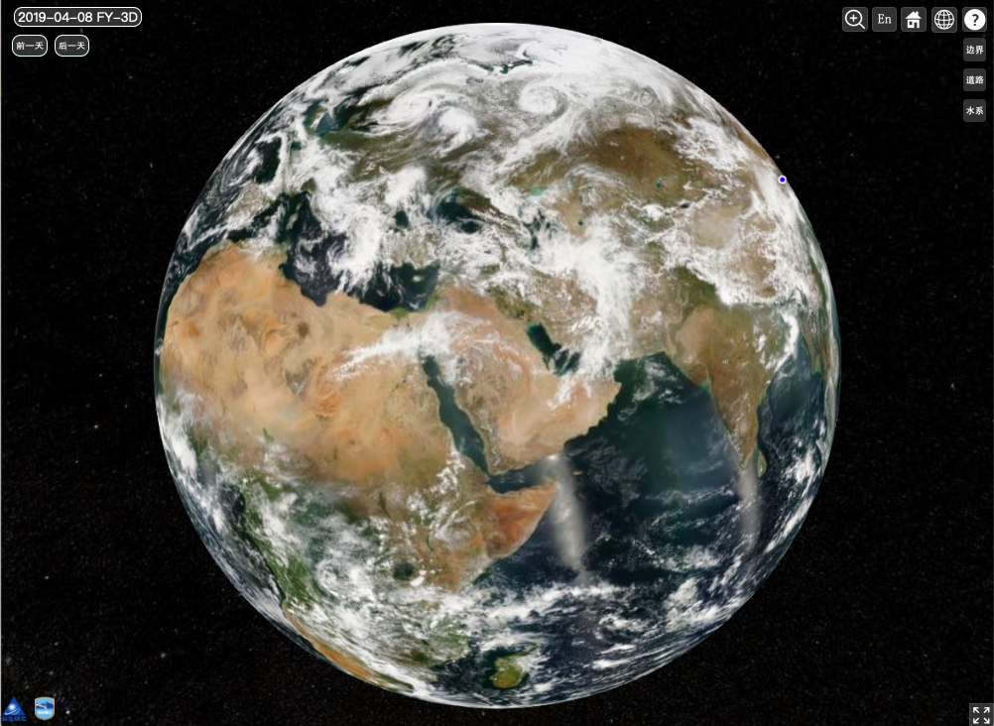
Prototype of FENGYUN “cloud+client “ remote sensing platform-LEO satellites
https://fy4.nsmc.org.cn/mips/index.html

Slide 38


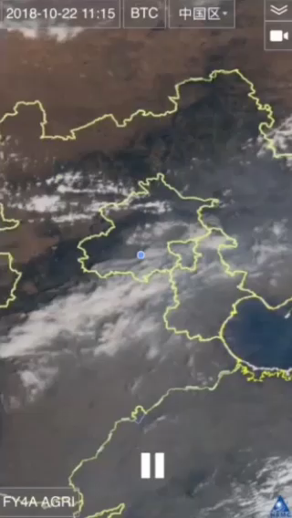
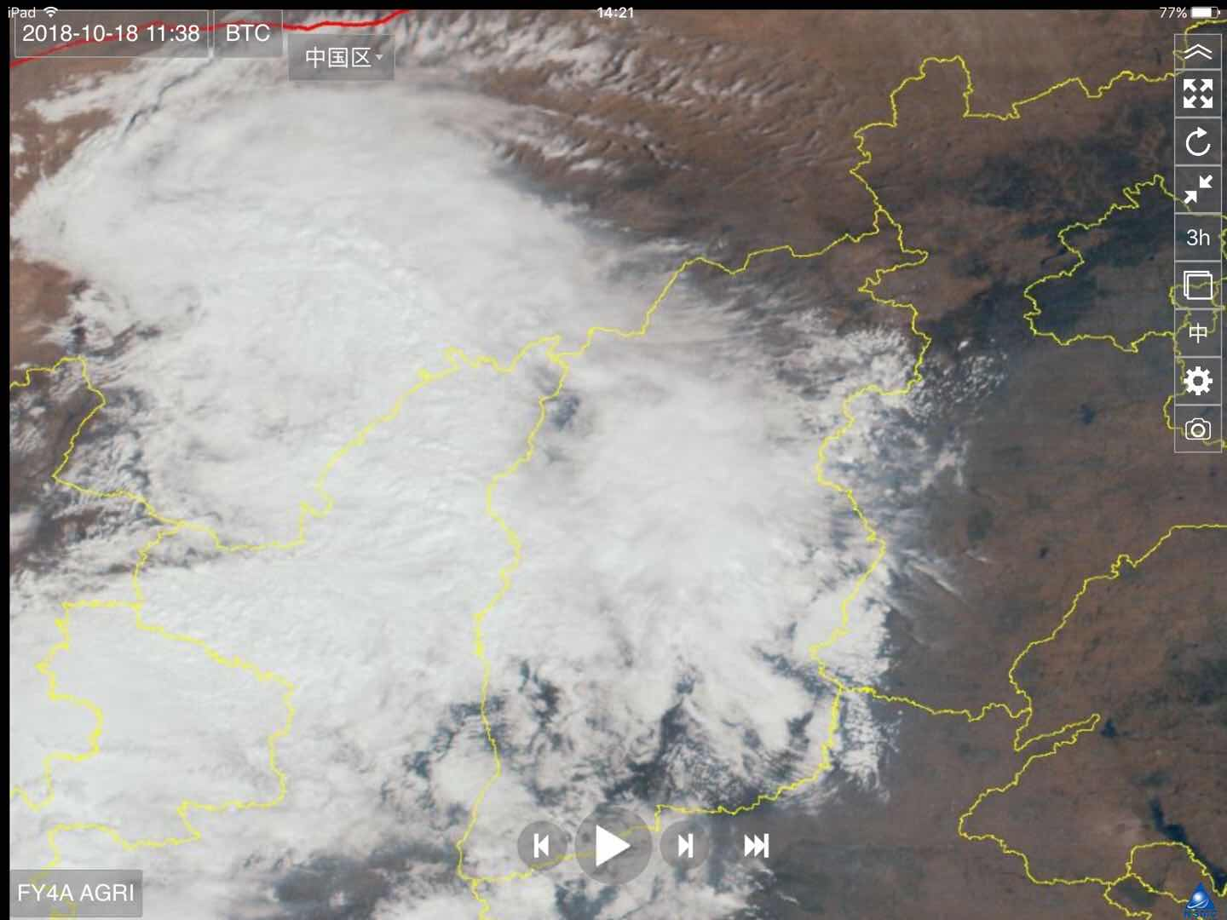
Mobile APPs
  “Fengyun Now” app
  Real-time cloud image release orientated mobile terminal

Slide 39

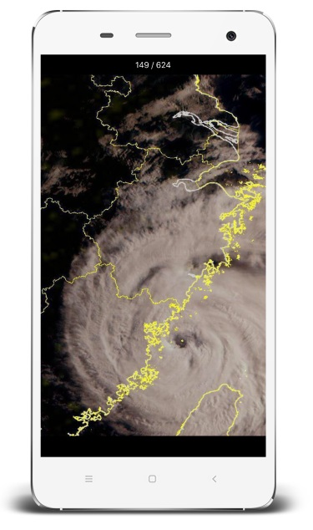


WeChat applets
Fengyun Now

Slide 40


WeChat applets
Fengyun Earth View

Slide 41


3、总体设计方案
Future：“Cloud + Client” Technology Architecture
Data Service
Easy Use
Easy Integreted
Deep Learning
AI Application
Data Reprocessing
Data Module
Data visualization service
Data customization service
Data publishing
service
Data
cloud sharing
service
Data quality service
Public platform
Big Data platform
Data Service platform
Application plug-in Market
Big Data computing
Data Archive platform
Process algorithm Market
Data processing engine
Data Service platform
Data products Market
Big Data Strogage Manage
Data Monitor platform
Cloud storage
Cloud host
Cloud network
Firewall service
Load balancing

Slide 42
Thanks
xiandi@cma.gov.cn

